Slide 1
Employee Management System Sprint-1
Team Members:
Shashvat Gupta(Team leader)
Siddharth Bajpai
Sourabh Khanna
Tavneet Singh Khurana
Vipin Dane
Yashraj yadav

Slide 2
Introduction
Employee Management System deals with three entities ‘Employee’ , ‘Project’ and ‘Manager’
and have functionalities that deals with the relation amoungh these entities.
Technologies Used
Java
Spring Boot Api
Spring Data Jpa
Junit
Swagger
DataBase Used
postgres

Slide 3
Entities for the Project
Employee entity
Manager entity
Project entity

Slide 4
Fields of Employee entity
Employee id
First Name
Last Name
Email id

Slide 5
Fields of manager entity
Manager id
First Name
Last Name
Email id

Slide 6
Fields of project entity
Project id
Project Name

Slide 7
Relationship among the entities
OneToMany between Manager and Employee.
ManyToMany Between Employee and Project.
OneToOne between Manager and Project.

Slide 8
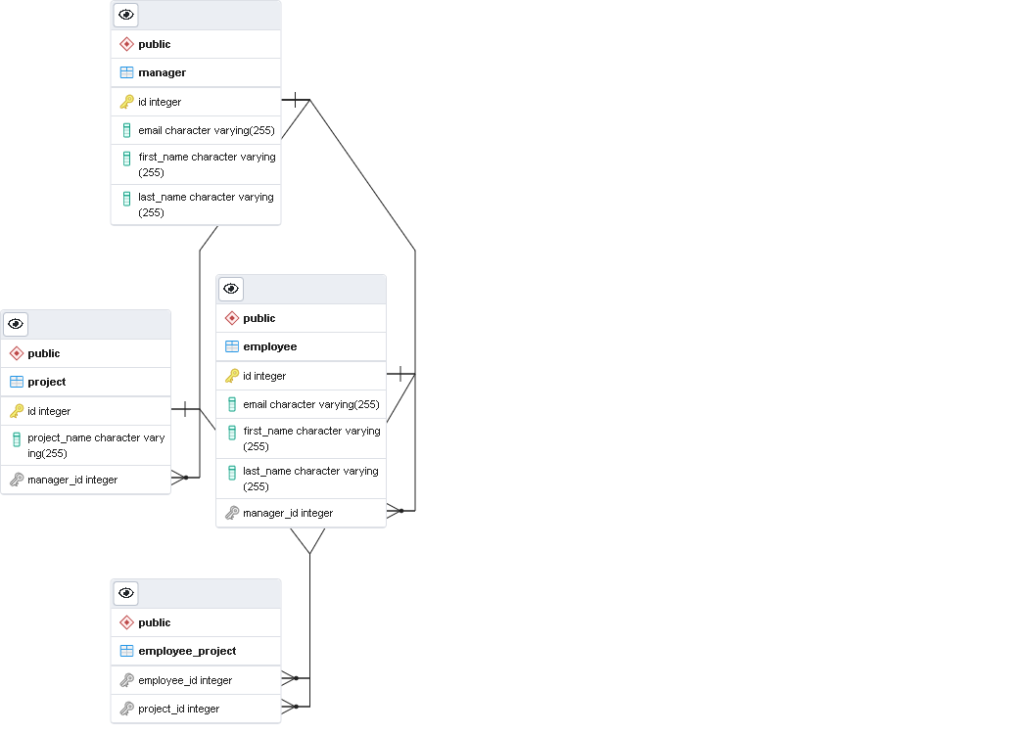
Entity Relationship diagram

Slide 9
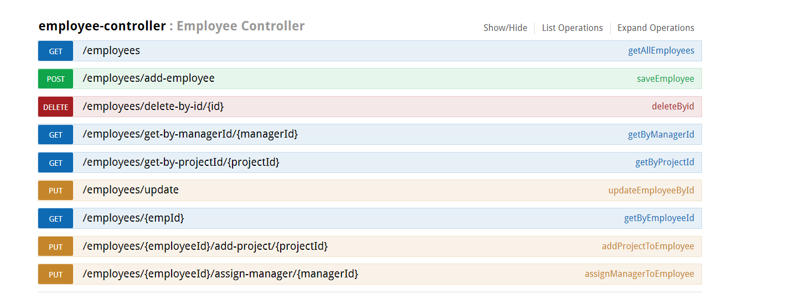
Functionalities of employee

Slide 10
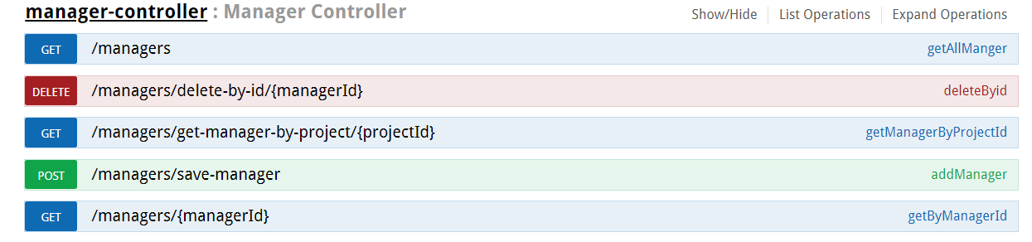
Functionalities of manager

Slide 11
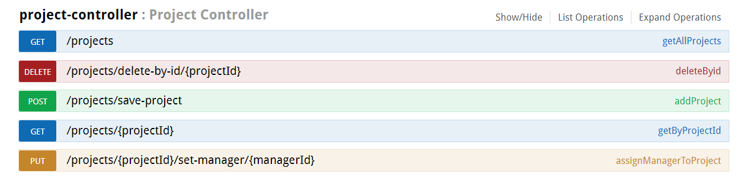
Functionalities of project

Slide 12
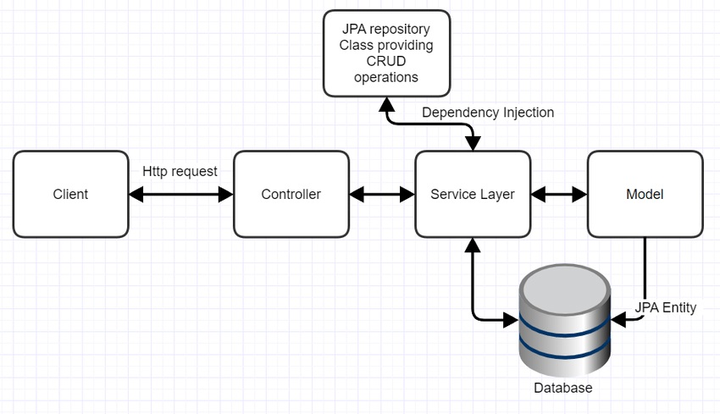
Architecture flow of spring boot application

Slide 13
Thankyou.

